Slide 1


Principal Component Analysis (PCA)
Dive into PCA, a powerful technique for simplifying complex datasets and uncovering valuable insights.

Slide 2
What is PCA?
PCA is an unsupervised learning technique designed for dimensionality reduction and data preprocessing, It reduces the number of dimensions in data while keeping essential information.
Dimensionality Reduction
Key Information
Enhanced Visualization
Simplifies high-dimensional data.
Focuses on most important variables.
Makes data easier to understand.

Slide 3

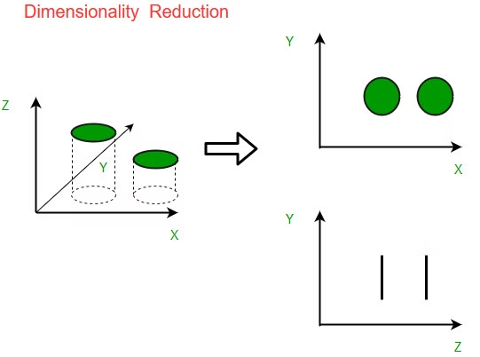

What is Dimensionality reduction?
Dimensionality reduction is a Machine Learning technique that reduces the number of dimensions (or variables, features) in a dataset while keeping the important information.
Common Dimensionality Reduction Techniques:
PCA , t-Distributed Stochastic Neighbor Embedding (t-SNE), Linear Discriminant Analysis (LDA), Autoencoders.
Why Use Dimensionality Reduction?
Efficiency
Visualization
Reduces calculation time and resources.
Makes it easier to visualize complex, high-dimensional data to lower (2D or 3D).
Avoiding Overfitting
Fewer dimensions can reduce the risk of overfitting by eliminating irrelevant or noisy features.

Slide 4

When Should You Use PCA?
High Dimensionality
Noise Reduction
Many features in the data.
Removes unnecessary information.
Data Visualization
Presents data in 2D or 3D.

Slide 5

How Does PCA Work?
PCA finds new axes (principal components) that capture most of the variance in the data.
Data Variance
1
PCA identifies directions of most variation.
Principal Components
2
New axes that capture most of the data's variance.
Data Transformation
3
Projecting data onto the principal components.

Slide 6
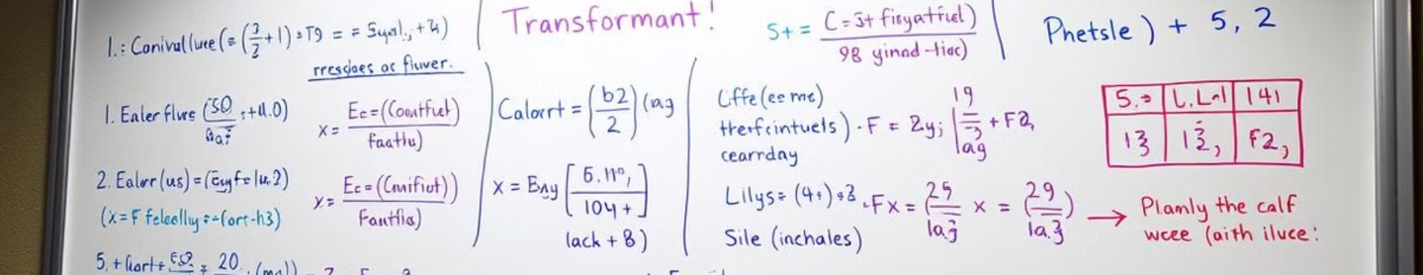
The Math Behind PCA
PCA relies on linear algebra to identify the most important directions in the data.
Covariance Matrix
Measures relationships between features.
Eigenvalues and Eigenvectors
Extracting the principal components.
Variance and Data Transformation
PCA transforms data onto new coordinates based on these components.

Slide 7
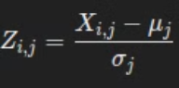
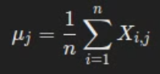
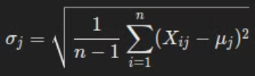
Steps to Perform PCA
1.Standardize Data:
For each feature (column):
Xi,j​ is the score of the i-th row in the j-th feature.
μj​ is the mean of the j-th feature : The mean is the sum of all data points divided by the number of points.
σj​ is the standard deviation of the j-th feature : measures how spread out ( far ) the data is from the mean.
Zi,j​ is the standardized value for the i-th row in the j-th feature.
n is the total number of samples(row).

Slide 8
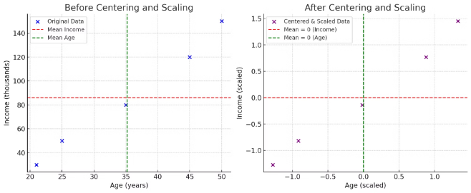
Why Standardize Data?
the feature with a larger range in values might dominate in analyses.
Why Mean = 0?
Centering data makes the mean = 0.
Focuses on variations instead of absolute values.
removes mean bias, simplifies calculations, and ensures fair comparisons across features.
2. Why Standard Deviation = 1?
Scaling ensures all features contribute equally.
Without scaling, features with larger ranges dominate, such as income over age.
scaling ensures that all features values have the same importance or weight.
3.Example Dataset: Income vs Age
Income: $30K to $150K.
Age: 21 to 50 years.
Standardizing removes bias caused by different units.

Slide 9
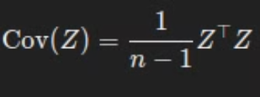
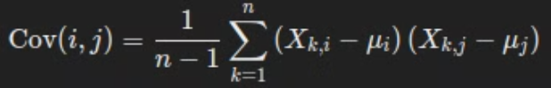
Steps to Perform PCA
2. Calculate Covariance Matrix
Compute the covariance matrix of the standardized dataset:
Z : Standardized dataset matrix ( n × m , n samples(row) by m features(column)).
n : Number of samples.
Each entry Cov(i,j) in the matrix is:
Xk,i​ and Xk,j​ are the values for the k-th sample in features i and j, respectively.
μi and μj are the means of features i and j.

Slide 10
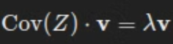
Steps to Perform PCA
3.Find Eigenvalues & Eigenvectors
Eigenvalues and eigenvectors are derived from the covariance matrix to identify the principal components.
v : Eigenvector (direction of principal component).
λ : Eigenvalue (amount of variance explained or captured by the component).
using Gaussian elimination or another matrix-solving technique to find the eigenvector.
Gaussian Elimination is a systematic method for solving systems of linear equations.

Slide 11
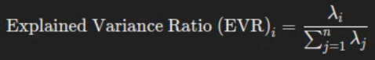
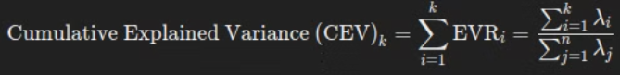
Steps to Perform PCA
4.Select Top Components
1-Sort Eigenvalues (λ):
Arrange eigenvalues λ1,λ2,…,λn​ in descending order.
Select the top k eigenvalues, λ1,λ2,…,λk, and their corresponding eigenvectors.
2-Principal Components:
The eigenvectors corresponding to the top k eigenvalues form the principal component axes.
λi​ is the eigenvalue of the i-th principal component.
in the bottom​ is the total sum of all eigenvalues.
EVR helps to understand how much of the dataset's variance is captured by each principal component.
3-Cumulative Explained Variance:
To determine the total variance explained by the top k components, sum their explained variance ratios:
The CEV shows how much of the total variance is captured by the top k components. By that avoiding retaining too many components, which might lead to overfitting or unnecessary complexity in the model.

Slide 12
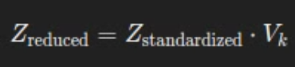
Steps to Perform PCA
5.Transform Data
Project the original data Z onto the selected principal components to reduce dimensionality.
Z standardized​: Standardized data matrix .
Vk​: Matrix of the top k eigenvectors (principal components).
Z reduced​: Transformed data matrix in k-dimensions space .
This transformation reduces the data from n-dimensions to k-dimensions.

Slide 13
Parameters and Hyperparameters
Parameters:
Explained Variance Ratio (EVR): The proportion of variance captured by each component after applying PCA.
Cumulative Variance Ratio (CVR): Cumulative sum of explained variance ratio, showing how much total variance is captured as components are added.
Hyperparameters:
Number of Components (n_components): Chosen based on desired variance retention (e.g., 70%-90%).
Solver (svd_solver): Algorithm used to compute PCA.
'auto': Selects the best solver based on data.
'full': Exact SVD, accurate but slower, best for small datasets.
'randomized': Approximate SVD, faster for large datasets.
'arpack': Uses Arnoldi method, suitable for sparse datasets.
The Arnoldi method is an iterative technique for approximating eigenvalues and eigenvectors of large, complex matrices.
SVD (Singular Value Decomposition) is a method that breaks a matrix into three parts to help reduce dimensions and extract important features in PCA.

Slide 14
Example on Students Dataset
dataset of students from Master 1 ISI (Omar, Mohamed, Osama, Aymen) with their average of each modules.
Student
BDD Advanced
Algo Advanced
Test & Validation
Management
ML
Outil Math for AI
English
Omar
12.5
13.5
10.0
12.0
14.0
11.0
13.0
Mohamed
11.0
12.0
12.5
10.5
11.5
13.0
10.5
Osama
10.0
10.5
14.0
11.0
12.5
12.0
11.5
Aymen
13.0
14.0
11.5
15.0
12.0
10.5
12.5
This matrix X is a 4×7 matrix (4 students, 7 modules).
let's apply on this students dataset , PCA algorithm step-by-step.

Slide 15
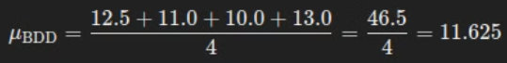
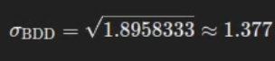
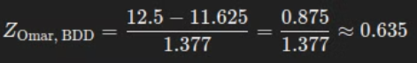
Example on Students Dataset
Step 1: Standardize the Data
Objective: We standardize the data so each module (feature) has a mean of 0 and a standard deviation of 1. This makes each feature comparable.
For the BDD Advanced module: XBDD​=[12.5,11.0,10.0,13.0]
1.Mean Calculation:
2.Standard Deviation Calculation:
3.Standardizing Each Value:
For Omar:
So after applying this to each student , ZBDD​=[0.635,−0.454,−1.181,1.000]

Slide 16
Standardized Matrix :
Student
BDD Advanced
Algo Advanced
Test & Validation
Management
ML
Outil Math for AI
English
Omar
0.635
1.074
-1.459
-0.220
1.786
-0.582
0.765
Mohamed
-0.454
0.000
0.364
-1.000
-0.446
1.174
-1.392
Osama
-1.181
-0.362
1.459
-0.220
0.446
0.446
-0.530
Aymen
1.000
1.361
-0.364
1.440
-0.786
-1.038
1.157
This is the fully standardized dataset. Each column now has a mean of 0 and a standard deviation of 1.

Slide 17
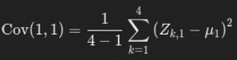
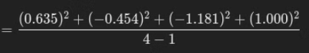
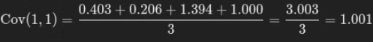
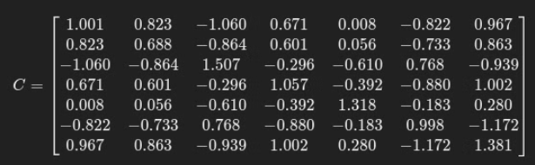
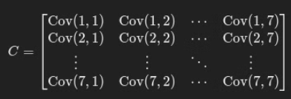
Step 2:
Feature j=1 is the first column (BDD Advanced). From the standardized dataset:
Z:,1=[0.635,−0.454,−1.181,1.000]
so C:
like this structure :
Cov(1,1): Variance of BDD Advanced,
Cov(1,2): Covariance between BDD Advanced and Algo Advanced,
Cov(2,3): Covariance between Algo Advanced and Test & Validation, And so on.

Slide 18
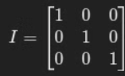
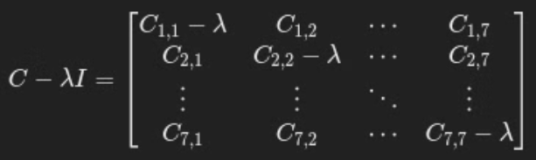
Step 3:
1.Find Eigenvalue : this : C*v=λ*v , Rewriting it: (C−λI)v=0 , where I is the identity matrix.
exmple I in 3×3 matrice :
For this equation to have (i.e., v≠0), the matrix (C−λI) must be singular (square matrix). A singular matrix has a determinant of 0, so:
det(C−λI)=0 , solving it gives the eigenvalues (λ).
For C(1,1) =1.001 : ​det(C−λI)=(1.001−λ)⋅(det of the remaining 6×6 matrix)
Eigenvalues (sorted in descending order): λ = [ 5.364 , 1.839 , 0.747 , 5.12 × 1 0 ^(- 16) , 3.65 × 1 0 ^(-17), − 2.59 × 1 0 ^(− 16) , − 9.68 × 1 0 ^(− 16) ] .

Slide 19
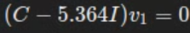
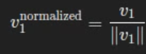
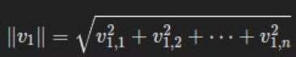
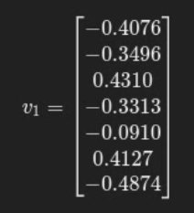
2.Find Eigenvectors:
For the first eigenvalue λ1​=5.364, the equation becomes :
so now solve this system : (−4.363)v1,1​ + (0.823)v1,2​ − (1.060)v1,3 ​+ (0.671)v1,4​ + (0.008)v1,5 ​− (0.822)v1,6 + (0.967)v1,7​ = 0
and then normalize v1 : we want to convert them into unit vectors & make their weight (magnitude)=1.
Each entry in the eigenvector corresponds to the contribution of each module (feature) to the eigenvalue λ1​.
A positive or negative value indicates the direction of the influence of that feature.
A larger absolute value means the feature has a stronger influence on the principal component corresponding to λ1​.

Slide 20
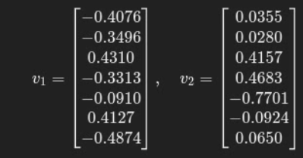
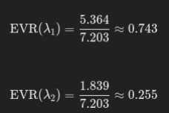
Step 4:
Lets select k=2 (reduce to 2 dimensions , k=n_component). The first two eigenvalues are:
λ1=5.364 , λ2=1.839
The corresponding eigenvectors are the first two columns of the eigenvector matrix:
∑λi​ = λ1​+λ2​= 5.364+1.839=7.203
CVR for top 1 eigenvalue (CVR1):
CVR1=EVR(λ1)=0.743 (74.3% of the variance)
CVR for top 2 eigenvalues (CVR2):
CVR2=EVR(λ1)+EVR(λ2)=0.743+0.255=0.998 (99.8% of the variance).
So, by selecting the top 2 principal components (corresponding to λ1​ and λ2​), we capture about 99.8% of the variance in the dataset.

Slide 21
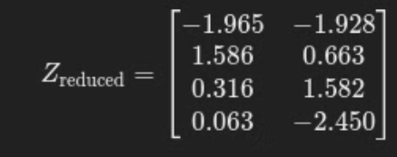
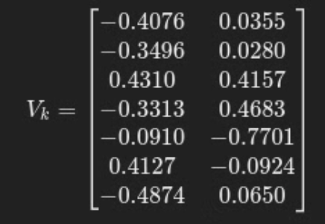
Step 5:
by multiply Z standardize * Vk , we got :
Vk : matrix of v: [v1 , v2]:
The dataset has been transformed into a 2-dimensional space using the top 2 principal components. The new dataset Zreduced retains almost all the information (99.8% of the variance) in a much simpler form, making it easier to analyze or visualize.

Slide 22
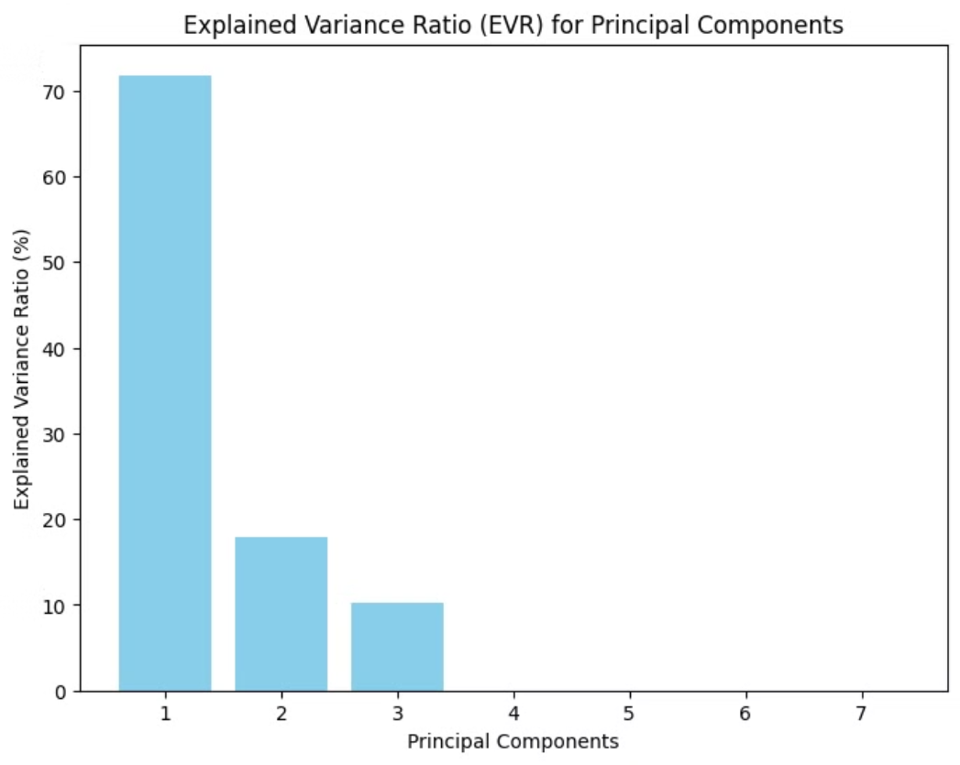
Plot

Slide 23
PCA Before Regression or Classification
PCA does not itself perform regression or classification because it is not a predictive model, it prepares the data for these tasks by reducing its dimensionality. Once PCA is applied:
The transformed dataset Z reduced​ is used as input to models like:
Linear Regression
Logistic Regression
SVM
Decision Trees, etc.
Why PCA Doesn't Perform Regression or Classification?
PCA works only with the input data (features) and reduces dimensions(features) without any knowledge of the target labels but Regression/Classification concept is learns from the target labels to predict outcomes.
a method that combines dimensionality reduction with classification or regression, techniques like LDA (Linear Discriminant Analysis).

Slide 24
How PCA Supports Regression or Classification :
1-Regression
A dataset with features like house size, number of rooms, neighborhood scores, distance to schools, basement, and air conditioning. PCA will be applied to reduce dimensionality before using linear regression.
1.Features:
Size: Total area of the house in square meters (numeric).
Rooms: Number of rooms in the house (numeric).
Neighborhood: Quality score of the neighborhood (scale of 1-10) (numeric).
Distance to School: Distance to the nearest school in km (numeric).
Basement: Whether the house has a basement (binary: 1 for Yes, 0 for No).
Air Conditioning: Whether the house has air conditioning (binary: 1 for Yes, 0 for No).
2. Problem: Some features (e.g., Size and Rooms) are highly correlated. PCA is applied to combine them into principal components, reducing redundancy and preserving essential information.
3.Solution : PCA will combine these features into principal components, reducing redundancy while preserving essential information.

Slide 25
4.Explained Variance Ratio (EVR):
PC1: 23.93% (explains variance in Size, Rooms)
PC2: 19.62% (captures secondary trends)
PC3: 15.62% (captures other minor trends)
Total Variance:CVR= 59.17% captured by the first three components.
5.Number of Components (n_components​):
The choice of n_components​ depends on the CVR.
Typically, we aim to retain at least 70-90% of the variance, In this case, using 3 components explains 59.17% of the variance, which is reasonable, considering the balance between variance retention and dimensionality reduction
Reducing features from 6 to 3 keeps the model simplified without losing too much information.
If you can achieve around 70% variance, try testing the model with 4 components and evaluate performance (on test data). If adding PC4 improves performance without overfitting , you can go with it. Otherwise, stick to 3.
PCA simplifies the data while retaining its essence, and next apply Linear regression on result of PCA : Z reduced (the reduced space) , to predict house prices achieving a simplified yet effective model.

Slide 26
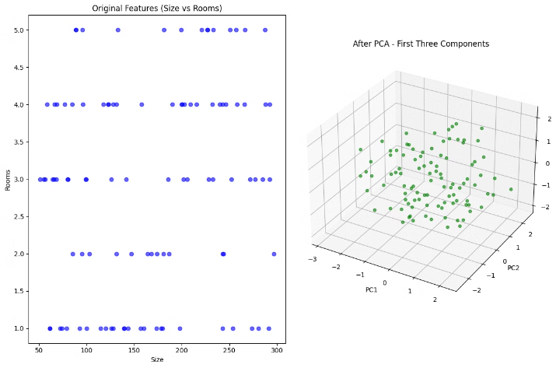
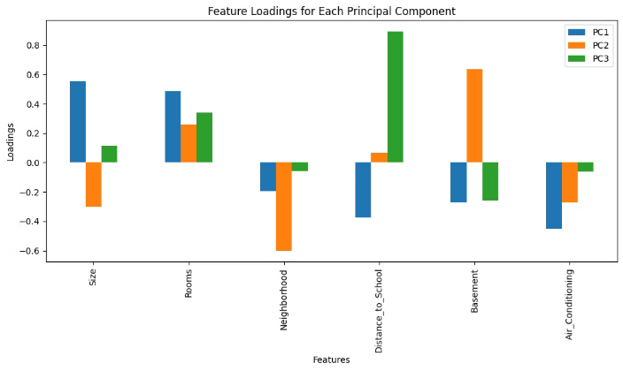
PC1: Size, Rooms, Air Conditioning (overall house size and amenities).
PC2: Basement, Distance to School, Rooms (location and amenities).
PC3: Basement, Rooms (variations in basement and room count).
PC3 mainly reflects variations in Basement and Rooms, which are already covered by PC1 and PC2. Discarding PC3 simplifies the model while still retaining most of the variance.

Slide 27
2-Classification
Dataset Example
Features: Blood pressure, cholesterol, and glucose levels (some may be highly correlated, e.g., glucose and cholesterol).
Target: Disease status (binary: Healthy or Not Healthy),
Why PCA?
Highly correlated features, such as glucose and cholesterol, may lead to overfitting by causing the model to focus on redundant patterns instead of meaningful trends.
PCA combines these correlated features, reducing redundancy and simplifying the data.
Steps
Use PCA to reduce dimensions (e.g., from 10 features to 3 principal components).
Train a classifier (e.g., Decision Tree or SVM) on the reduced dataset.
Outcome
Reduced complexity, faster training, and a model that generalizes better without overfitting.

Slide 28








Pros and Cons
PCA offers advantages but also has limitations.
Simplifies Data
Improves Visualization
Reduces Noise
Improve performance
Reduces complexity and dimensionality.
Removes irrelevant information.
Easier to understand.
by reducing overfitting.
Non-Linear Data
Hard interpret
Sensitive to scaling
Loss of Information
Not suitable for all datasets.
Data becomes harder to interpret.
requiring standardization.
if the n_components chosen is too low.

